Slide 1

Student Management System
A Console-Based Java and Hibernate Project
Presented by: Amarjeet Mistri

Slide 2
Project Overview & Objectives
Overview
Objectives
A console-based application designed to efficiently manage student, course, and fee data. Developed using Java and Hibernate, it provides a robust and reliable system for educational institutions.
Streamline student data management.
Automate course and fee tracking.
Provide a user-friendly console interface.
Ensure data persistence and integrity.

Slide 3




Technologies Used
Java
Hibernate
Core programming language for application logic.
ORM framework for seamless database interaction.
MySQL
Relational database for data storage.

Slide 4





Project Architecture: Layered Design
The system employs a layered architecture for modularity and maintainability.
Console Input Layer
Handles user interaction and input from the console.
Service Layer
Contains business logic and orchestrates data operations.
DAO Layer
Data Access Objects for interacting with the database.
MySQL Database
Persistent storage for all application data.

Slide 5

Main Functional Modules
Student Module
Course Module
Add, update, delete, and view student records.
Manage course details and assignments.
Fees Module
Search Module
Track student fee payments and balances.
Search for students, courses, or fees using various criteria.

Slide 6
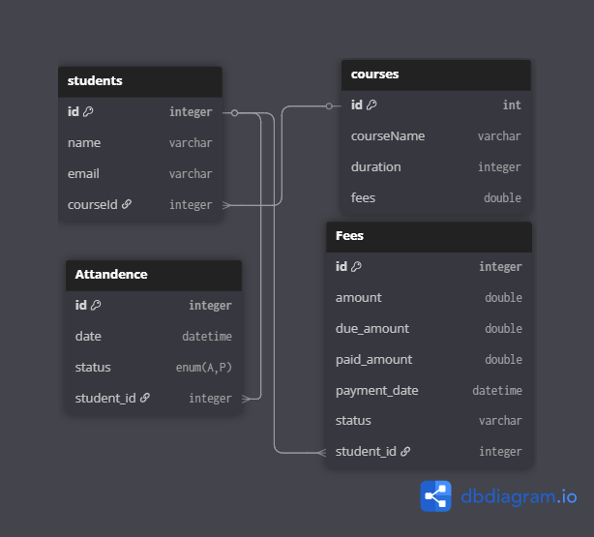
Entity-Relationship Diagram
Visual representation of the database schema and relationships between key entities.

Slide 7

Challenges Faced During Development
Hibernate Configuration: Initial setup and mapping complexities, particularly with different database dialects and connection pooling.
Console Input Handling: Ensuring robust and error-free user input parsing and validation in a text-based environment.
Relationship Management: Correctly defining and managing one-to-many and many-to-many relationships between entities in Hibernate.

Slide 8

Future Enhancements
1
CSV Export Functionality
Allow data to be exported to CSV format for reporting and external use.
2
Comprehensive Unit Testing
Develop extensive unit tests for all modules to ensure code reliability and stability.
3
GUI or Spring Boot Upgrade
Transition to a graphical user interface (GUI) or a web-based application using Spring Boot for enhanced user experience and scalability.

Slide 9

Conclusion & Learnings
This project provided invaluable experience in full-stack Java development, focusing on database interaction with Hibernate. It honed skills in layered architecture, object-relational mapping, and robust console application design. The challenges encountered were significant learning opportunities, reinforcing the importance of meticulous configuration and error handling. This foundation is crucial for future, more complex enterprise applications.

Slide 10
Q & A
Project By: Amarjeet Mistri

